Slide 1

An view of C++0x
Bjarne Stroustrup
Texas A&M University
http://www.research.att.com/~bs

Slide 2
Abstract
What does C++0x offer real-world programmers? This tutorial presents some key C++0x language features and standard library components with an emphasis on their use and utility. Design aims and principles are discussed with small code examples
The new language facilities are presented, sarting with two larger case studies: initialization and support for concurrency (threads, locks, futures, async()). After that, “minor” features are presented: such as scoped and strongly typed enums, generalized and guaranteed constant expressions, control of class defaults, range for statement, lambdas, user-defined literals, and variadic templates. Since long lists of features are tedious, the presentation is example driven and emphasis is placed on rationale. Several language features are closely integrated with standard-library support : initializers, support for concurrency (threads, locks, futures, async()). Others, are the basis for improvements to the standard library. Consequently, this section makes frequent reference to the C++0x standard library.
The final part of the tutorial gives an overview of new standard library features: improvements to containers (hashed containers, initializer-list constructors, emplace operations), the garbage collection ABI, metaprogramming facilities (function, tuple, bind), regular expressions, and resource management pointers (unique_ptr and shared_ptr). Again, the presentation is focused on examples rather than details of library components.
2*120 minutes (incl Q&A)

Slide 3

Overview
C++: Aims, Ideals, and history
Design rules for C++0x
With small examples
Case studies
Initialization
Concurrency
…
The standard library
Containers
Regular expressions
…

Slide 4

Programming languages
A programming language exists to help people express ideas
Programming language features exist to serve design and programming techniques
The primary value of a programming language is in the applications written in it
The quest for better languages has been long and must continue

Slide 5



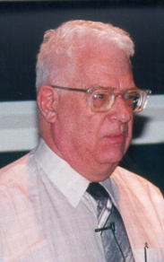

Programming Languages
Domain-specific abstraction
General-purpose abstraction
Fortran
Simula
Java
Cobol
C++
C++0x
Direct mapping to hardware
Assembler
BCPL
C
C#

Slide 6
Ideals
Work at the highest feasible level of abstraction
More general, correct, comprehensible, and maintainable code
Represent
concepts directly in code
independent concepts independently in code
Represent relationships among concepts directly
For example
Hierarchical relationships (object-oriented programming)
Parametric relationships (generic programming)
Combine concepts
freely
but only when needed and it makes sense

Slide 7
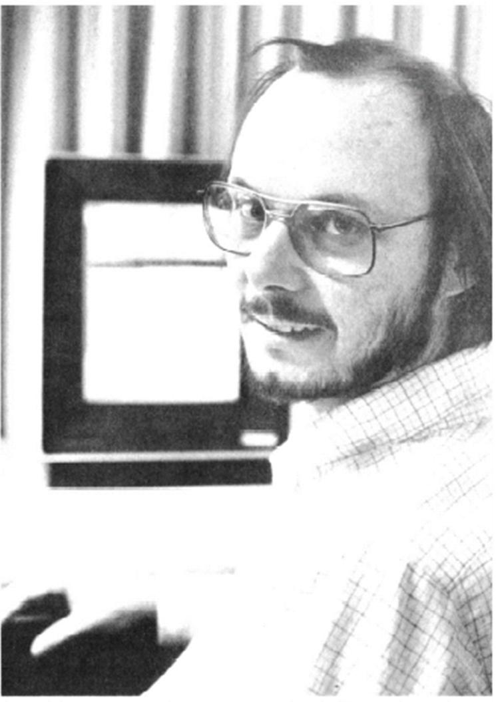
C++ timeline
General abstraction mechanisms to cope with complexity
From Simula
General close-to-hardware machine model for efficiency
From C
“C with Classes” 1980
Became C++ in 1984
Commercial release 1985
Non-commercial source license: $75
ISO standard 1998
2nd ISO standard 200x (‘x’ is hex ☹)

Slide 8
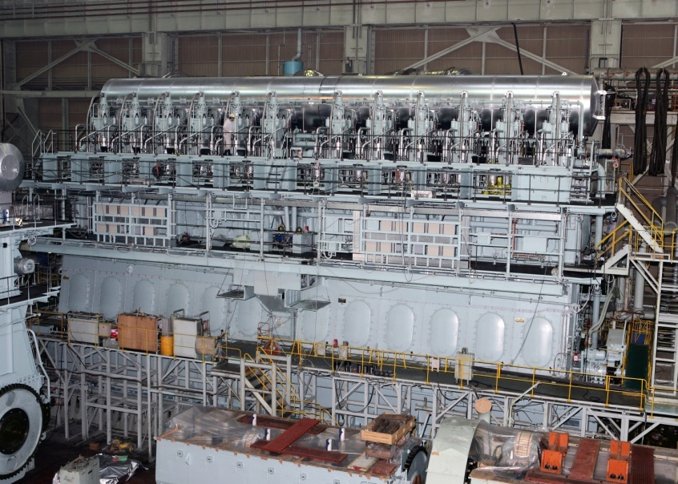




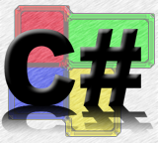

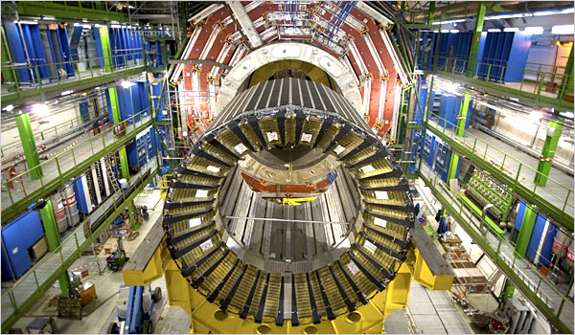


C++ applications

Slide 9
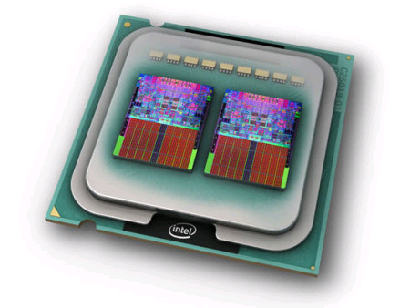








C++ Applications
www.research.att.com/~bs/applications.html

Slide 10











C++ Applications
www.lextrait.com/vincent/implementations.html

Slide 11
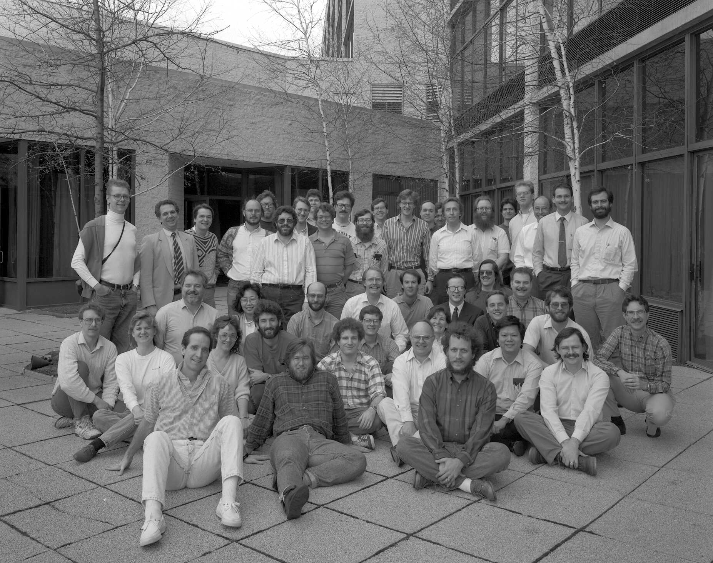
C++ ISO Standardization
Slow, bureaucratic, democratic, formal process
“the worst way, except for all the rest”
(apologies to W. Churchill)
About 22 nations (5 to 12 at a meeting)
Membership have varied
100 to 200+
200+ members currently
40 to 100 at a meeting
~60 currently
Most members work in industry
Most members are volunteers
Even many of the company representatives
Most major platform, compiler, and library vendors are represented
E.g., IBM, Intel, Microsoft, Sun
End users are underrepresented

Slide 12
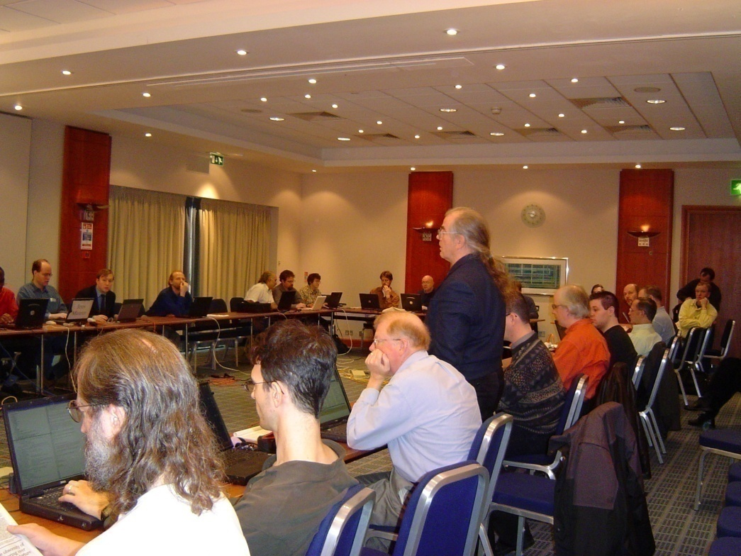
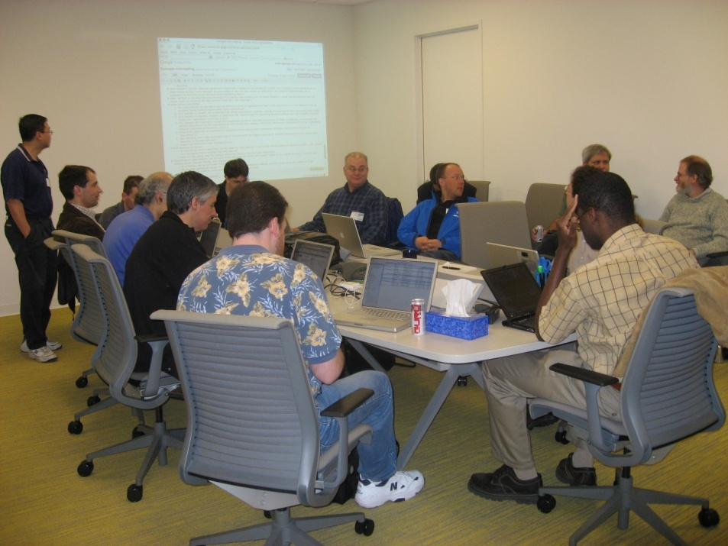
Design?
Can a committee design?
No (at least not much)
Few people consider or care for the whole language
Is C++0x designed
Yes
Well, mostly: You can see traces of different personalities in C++0x
Committees
Discuss
Bring up problems
“Polish”
Are brakes on innovation

Slide 13
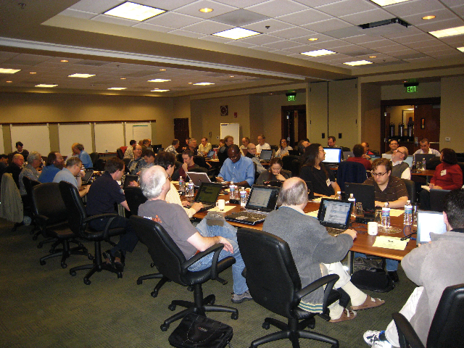
Overall goals for C++0x
Make C++ a better language for systems programming and library building
Rather than providing specialized facilities for a particular sub-community (e.g. numeric computation or Windows-style application development)
Build directly on C++’s contributions to systems programming
Make C++ easier to teach and learn
Through increased uniformity, stronger guarantees, and facilities supportive of novices (there will always be more novices than experts)

Slide 14
C++0x
‘x’ may be hex, but C++0x is not science fiction
Every feature is implemented somewhere
E.g. GCC 4.6: Rvalues, Variadic templates, Initializer lists, Static assertions, auto-typed variables, New function declarator syntax, Lambdas, Right angle brackets, Extern templates, Strongly-typed enums, Delegating constructors (patch), Raw string literals, Defaulted and deleted functions, Inline namespaces, Local and unnamed types as template arguments, range for loop, …
Microsoft: lambdas, auto, concurrency, …
Standard library components are shipping widely
E.g. GCC, Microsoft, Boost
The last design points have been settled
barring formal requests from National Standards Bodies
And they tend to be very conservative

Slide 15
Rules of thumb / Ideals
Integrating features to work in combination is the key
And the most work
The whole is much more than the simple sum of its part
Maintain stability and compatibility
Prefer libraries to language extensions
Prefer generality to specialization
Support both experts and novices
Increase type safety
Improve performance and ability to work directly with hardware
Make only changes that change the way people think
Fit into the real world

Slide 16
Maintain stability and compatibility
“Don’t break my code!”
There are billions of lines of code “out there”
There are millions of C++ programmers “out there”
“Absolutely no incompatibilities” leads to ugliness
We introduce new keywords as needed: auto (recycled), decltype, constexpr, thread_local, nullptr
Example of incompatibility:
static_assert(4<=sizeof(int),"error: small ints");
“Absolutely no incompatibilities” leads to absurdities
_Bool // C99 boolean type
typedef _Bool bool; // C99 standard library typedef

Slide 17
Support both experts and novices
Example: minor syntax cleanup
vector<list<int>> vl; // note the “missing space”
Example: simplified variable definition
auto x = 7.2; // x is a double
Example: simplified iteration
for (auto x : v) // for all x in v
cout << x <<'\n';
Note: Experts don’t easily appreciate the needs of novices
Example of what we couldn’t get just now
string s = "12.3";
double x = lexical_cast<double>(s); // extract value from string

Slide 18
Prefer libraries to language extensions
Libraries deliver more functionality
Libraries are immediately useful
Problem: Enthusiasts prefer language features
see library as 2nd best
Example: New library components
std::thread, std::future, …
Threads ABI; not thread built-in type
std::unordered_map, std::regex, …
Not built-in associative array
Example: Mixed language/library extension
The new for works for every type with a begin() and an end()
The new initializer lists are based on std::initializer_list<T>
vector<string> v = { "Nygaard ", "Ritchie" };
for (auto& x : {y,z,ae,ao,aa}) cout << x <<'\n';

Slide 19
Prefer generality to specialization
Example: Prefer improvements to abstraction mechanisms over separate new features
Inherited constructor
template<class T> class Vector : std::vector<T> {
using vector::vector<T>; // inherit all constructors
// …
};
Move semantics supported by rvalue references
vector<int> make_sequence(int n) // note return by value
{
vector<int> res;
// put n values into res;
return res;
};
Problem: people love small isolated features

Slide 20
Increase type safety
Approximate the unachievable ideal
Example: Strongly-typed enumerations
enum class Color { red, blue, green };
int x = Color::red; // error: no Color->int conversion
Color y = 7; // error: no int->Color conversion
Color z = red; // error: red not in scope
Color c = Color::red; // fine
Example: Support for general resource management
std::unique_ptr (for ownership)
std::shared_ptr (for sharing)
Garbage collection ABI

Slide 21
Improve performance and the ability to work directly with hardware
Embedded systems programming is very important
Example: address array/pointer problems
array<int,7> s; // fixed-sized array
Example: Generalized constant expressions (think ROM)
constexpr int abs(int i) { return (0<=i) ? i : -i; } // can be constant expression
struct Point {
int x, y;
constexpr Point(int xx, int yy) : x{xx}, y{yy} { } // “literal type”
};
constexpr Point p1{1,2}; // must be evaluated at compile time: ok
constexpr Point p2{1,abs(x)}; // ok?: is x is a constant expression?

Slide 22
Make only changes that change the way people think
Think/remember:
Object-oriented programming
Generic programming
Concurrency
…
But, most people prefer to fiddle with details
So there are dozens of small improvements
All useful somewhere
long long, static_assert, raw literals, thread_local, unicode types, …
Example: A null pointer keyword
void f(int);
void f(char*);
f(0); // call f(int);
f(nullptr); // call f(char*);

Slide 23
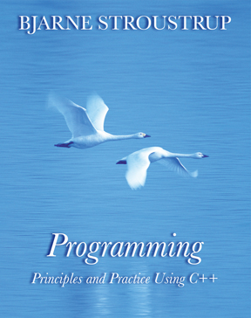
Fit into the real world
Example: Existing compilers and tools must evolve
Simple complete replacement is impossible
Tool chains are huge and expensive
There are more tools than you can imagine
C++ exists on many platforms
So the tool chain problems occur N times
(for each of M tools)
Example: Education
Teachers, courses, and textbooks
Often mired in 1970s thinking (“C is the perfect language”)
Often mired in 1980s thinking (“OOP: Rah! Rah!! Rah!!!”)
“We” haven’t completely caught up with C++98!
“legacy code breeds more legacy code”

Slide 24
Areas of language change
Machine model and concurrency Model
Threads library (std::thread)
Atomics ABI
Thread-local storage (thread_local)
Asynchronous message buffer (std::future)
Support for generic programming
(no concepts ☹)
uniform initialization
auto, decltype, lambdas, template aliases, move semantics, variadic templates, range-for, …
Etc.
static_assert
improved enums
long long, C99 character types, etc.
…

Slide 25
Standard Library Improvements 1
New containers
Hash Tables (unordered_map, etc.)
Singly-linked list (forward_list)
Fixed-sized array (array)
Container improvements
Move semantics (e.g. push_back)
Intializer-list constructors
Emplace operations
Scoped allocators
More algorithms (just a few)
Concurrency support
thread, mutex, lock, …
future, async, …
Atomic types
Garbage collection ABI

Slide 26
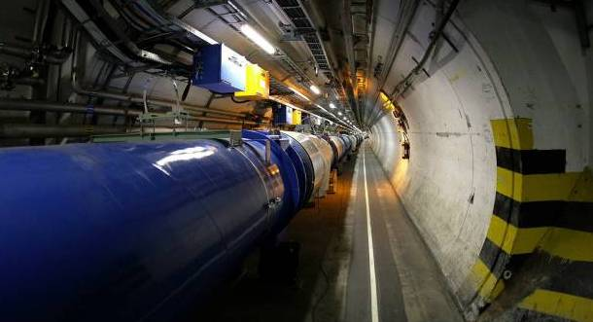
Standard Library Improvements 2
Regular Expressions (regex)
General-purpose Smart Pointers (unique_ptr, shared_ptr, …)
Extensible Random Number Facility
Enhanced Binder and function wrapper (bind and function)
Mathematical Special Functions
Tuple Types (tuple)
Type Traits (lots)

Slide 27
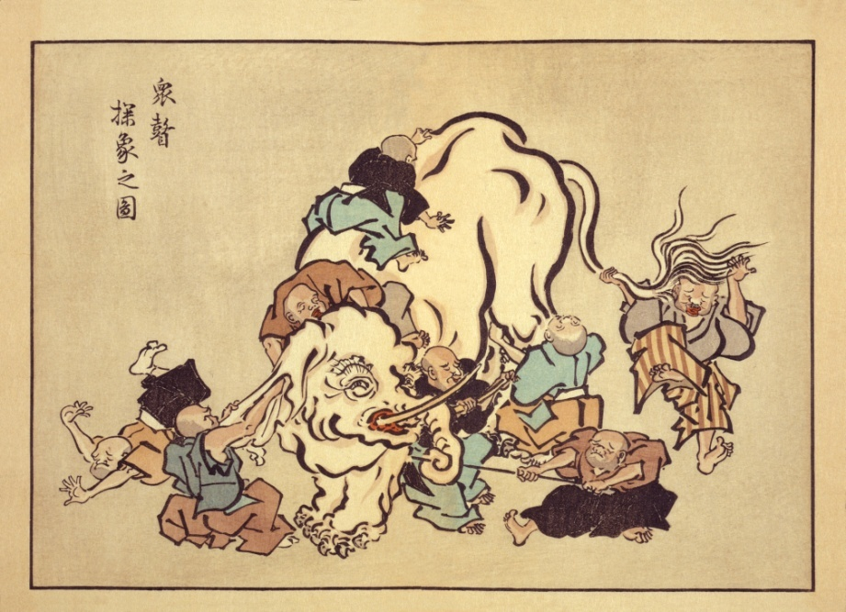
What is C++?
Template meta-programming!
A hybrid language
A multi-paradigm programming language
Buffer overflows
It’s C!
Embedded systems programming language
Too big!
Supports
generic programming
Low level!
An object-oriented programming language
A random collection of features

Slide 28
C++0x
It feels like a new language
Compared to C++98
How can I categorize/characterize it?
It’s not just “object oriented”
Many of the key user-defined abstractions are not objects
Types
Classifications and manipulation of types (types of types)
I miss “concepts”
Algorithms (generalized versions of computation)
Resources and resource lifetimes
The pieces (language features) fit together much better than they used to

Slide 29

C++
Key strength:
Building software infrastructures and resource-constrained applications
A light-weight abstraction programming language

Slide 30
So, what does “light-weight abstraction” mean?
The design of programs focused on the design, implementation, and use of abstractions
Often abstractions are organized into libraries
So this style of development has been called “library-oriented”
C++ emphasis
Flexible static type system
Small abstractions
Performance (in time and space)
Ability to work close to the hardware

Slide 31

Case studies
Initialization
“language maintenance”
Simplification through generalization
Concurrency
“driven by necessity”
“Minor” features
Variadic templates
Move semantics
…

Slide 32
Case study: Initializers
The problems
#1: Irregularity
#2: Lack of adequate variable length list mechanism
#3: Narrowing
Constraints
About 35 years of history
The bigger picture
Uniform initialization syntax and semantics needed
The solution
{ } uniform initialization
Uniform syntax
Uniform semantics

Slide 33
Problem #1: irregularity
There are four notations
int a = 2; // “assignment style”
int aa[] = { 2, 3 }; // “list style”
complex z(1,2); // “functional style”
x = Ptr(y); // “functional style” for conversion/cast/construction
No notation can be used everywhere
p = (new int = 2); // error: no = initialization for free store objects
complex z{1,2}; // error: complex has a constructor
int aa[](2,3); // error: an array doesn’t have a constructor
x = Ptr{3}; // syntax error: you can’t cast from a list

Slide 34
Problem #1: irregularity
Sometimes, the syntax is inconsistent/confusing
int a(1); // variable definition
int b(); // function declaration
int b(foo); // variable definition or function declaration
We can’t use initializer lists except in a few cases
string a[] = { "foo", " bar" }; // ok: initialize array variable
vector<string> v = { "foo", " bar" }; // error: initialize vector variable
void f(string a[]);
f( { "foo", " bar" } ); // error: initializer array argument

Slide 35
Is irregularity a real problem?
Yes, a major source of confusion and bugs
Violates fundamental C++ design principle:
Uniform support for types (user-defined and built-in)
Can it be solved by restriction?
No existing syntax can be used in all cases
int a [] = { 1,2,3 }; // can’t use () here
complex<double> z(1,2); // can’t use { } here
struct S { double x,y; } s = {1,2}; // can’t use ( ) here
int* p = new int(4); // can’t use { } or = here
No existing syntax has the same semantics in all cases
typedef char* Pchar;
Pchar p(7); // error (good!)
Pchar p = Pchar(7); // “legal” (ouch!)

Slide 36
Problem #2: list workarounds
Initialize a vector (using push_back)
Clumsy and indirect
template<class T> class vector {
// …
void push_back(const T&) { /* … */ }
// …
};
vector<double> v;
v.push_back(1); v.push_back(2); v.push_back(3.4);
Violates fundamental C++ design principle:
Support fundamental notions directly (“state intent”)

Slide 37
Problem #2: list workarounds
Initialize vector (using general iterator constructor)
Awkward, error-prone, and indirect
Spurious use of (unsafe) array
template<class T> class vector {
// …
template <class Iter>
vector(Iter first, Iter last) { /* … */ }
// …
};
int a[ ] = { 1, 2, 3.4 }; // bug
vector<double> v(a, a+sizeof(a)/sizeof(int)); // hazard
Violates fundamental C++ design principle:
Support user-defined and built-in types equally well

Slide 38
C++0x: initializer lists
An initializer-list constructor
defines the meaning of an initializer list for a type
template<class T> class vector {
// …
vector(std::initializer_list<T>); // initializer list constructor
// …
};
vector<double> v = { 1, 2, 3.4 };
vector<string> geek_heros = {
"Dahl", "Kernighan", "McIlroy", "Nygaard ", "Ritchie", "Stepanov"
};

Slide 39
C++0x: initializer lists
Not just for templates and constructors
but std::initializer list is simple – does just one thing well
void f(int, std::initializer_list<int>, int);
f(1, {2,3,4}, 5);
f(42, {1,a,3,b,c,d,x+y,0,g(x+a),0,0,3}, 1066);

Slide 40
Uniform initialization syntax
Every form of initialization can accept the { … } syntax
X x1 = X{1,2};
X x2 = {1,2}; // the = is optional
X x3{1,2};
X* p2 = new X{1,2};
struct D : X {
D(int x, int y) :X{x,y} { /* … */ };
};
struct S {
int a[3];
S(int x, int y, int z) :a{x,y,z} { /* … */ }; // solution to old problem
};

Slide 41
Uniform initialization semantics
X { a } constructs the same value in every context
{ } initialization gives the same result in all places where it is legal
X x{a};
X* p = new X{a};
z = X{a}; // use as cast
f({a}); // function argument (of type X)
return {a}; // function return value (function returning X)
…
X { … } is always an initialization
X var{} // no operand; default initialization
Not a function definition like X var();
X var{a} // one operand
Never a function definition like X var(a); (if a is a type name)

Slide 42
Initialization problem #3: narrowing
C++98 implicitly truncates
int x = 7.3; // Ouch!
char c = 2001; // Ouch!
int a[] = { 1,2,3.4,5,6 }; // Ouch!
void f1(int); f1(7.3); // Ouch!
void f2(char); f2(2001); // Ouch!
void f3(int[]); f3({ 1,2,3.4,5,6 }); // oh! Another problem
A leftover from before C had casts!
Principle violated: Type safety
Solution:
C++0x { } initialization doesn’t narrow.
all examples above are caught

Slide 43
Uniform Initialization
Example
Table phone_numbers = {
{ "Donald Duck", 2015551234 },
{ “Mike Doonesbury", 9794566089 },
{ "Kell Dewclaw", 1123581321 }
};
What is Table?
a map? An array of structs? A vector of pairs? My own class with a constructor? A struct needing aggregate initialization? Something else?
We don’t care as long as it can be constructed using a C-style string and an integer.
Those numbers cannot get truncated

Slide 44
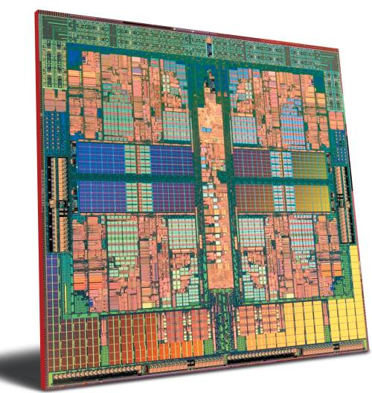
Case study
Concurrency
“driven by necessity”
More than ten years of experience

Slide 45

Case study: Concurrency
What we want
Ease of programming
Writing correct concurrent code is hard
Portability
Uncompromising performance
System level interoperability
We can’t get everything
No one concurrency model is best for everything
De facto: we can’t get all that much
“C++ is a systems programming language”
(among other things) implies serious constraints

Slide 46
Case study: Concurrency
What we want
Ease of programming
Writing correct concurrent code is hard
Portability
Uncompromising performance
System level interoperability
We can’t get everything
No one concurrency model is best for everything
De facto: we can’t get all that much
“C++ is a systems programming language”
(among other things) implies serious constraints

Slide 47
Concurrency
Not
Massively parallel (scientific) computing
Web services
Simple high-level abstract model
System of real-time guarantees
Instead
A systems-level foundation for all
Portability
For much multi-threaded code
Type safety
No need for casts and void*s to use tasks

Slide 48
Concurrency overview
Foundation
Memory model
atomics
Concurrency library components
std::thread
std::mutex (several)
std::lock (several)
std::condition (several)
std::future, std::promise, std::packaged_task
std::async()
Resource management
std::unique_ptr, std::shared_ptr
GC ABI

Slide 49
Memory model
// thread 2:
char b;
b = 1;
int y = b;
A memory model is an agreement between the machine architects and the compiler writers to ensure that most programmers do not have to think about the details of modern computer hardware.
// thread 1:
char c;
c = 1;
int x = c;
x==1 and y==1 as anyone would expect
(but don’t try that for two bitfields of the same word)

Slide 50
Memory model
Two threads of execution can update and access separate memory locations without interfering with each other.
But what is a “memory location?”
A memory location is either an object of scalar type or a maximal sequence of adjacent bit-fields all having non-zero width.
For example, here S has exactly four separate memory locations:
struct S {
char a; // location #1
int b:5, // location #2
unsigned c:11,
unsigned :0, // note: :0 is "special“
unsigned d:8; // location #3
struct {int ee:8;} e; // location #4
};

Slide 51
Atomics (“here be dragons!”)
Components for fine-grained atomic access
provided via operations on atomic objects (in <cstdatomic>)
Low-level, messy, and shared with C (making the notation messy)
what you need for lock-free programming
what you need to implement std::thread, std::mutex, etc.
Several synchronization models, CAS, fences, …
enum memory_order { // regular (non-atomic) memory synchronization order
memory_order_relaxed, memory_order_consume, memory_order_acquire, memory_order_release, memory_order_acq_rel, memory_order_seq_cst
};
C atomic_load_explicit(const volatile A* object, memory_order);
void atomic_store_explicit(volatile A *object, C desired, memory_order order);
bool atomic_compare_exchange_weak_explicit(volatile A* object, C * expected, C desired, memory_order success, memory_order failure);
// … lots more …

Slide 52
Threading
You can
Spawn threads
Wait for a thread to finish
wait for a thread for a specified time
control access to some data by mutual exclusion
control access to some data using locks
wait for an action of another task using a condition variable
return a value from a thread through a future

Slide 53
Concurrency: std::thread
#include<thread>
void f() { std::cout << "Hello "; }
struct F {
void operator()() { std::cout << "parallel world "; }
};
int main()
{
std::thread t1{f}; // f() executes in separate thread
std::thread t2{F()}; // F()() executes in separate thread
} // spot the bugs

Slide 54
Concurrency: std::thread
int main()
{
std::thread t1{f}; // f() executes in separate thread
std::thread t2{F()}; // F()() executes in separate thread
t1.join(); // wait for t1
t2.join(); // wait for t2
}
// and another bug: don’t write to cout without synchronization

Slide 55
Thread – pass arguments
Use function object or bind()
void f(vector<double>&);
struct F {
vector<double>& v;
F(vector<double>& vv) :v{vv} { }
void operator()();
};
int main()
{
std::thread t1{std::bind(f,some_vec)}; // f(some_vec)
std::thread t2{F(some_vec)}; // F(some_vec)()
t1.join(); t2.join();
}

Slide 56
Thread – pass arguments
Use bind() or variadic constructor
void f(vector<double>&);
struct F {
vector<double>& v;
F(vector<double>& vv) :v{vv} { }
void operator()();
};
int main()
{
std::thread t1{std::bind(f,some_vec)}; // f(some_vec)
std::thread t2{f,some_vec}; // f(some_vec)
t1.join(); t2.join();
}

Slide 57
Thread – pass result (primitive)
void f(vector<double>&, double* res); // place result in res
struct F {
vector& v; double* res;
F(vector<double>& vv, double* p) :v{vv}, res{p} { }
void operator()(); // place result in res
};
int main()
{
double res1; double res2;
std::thread t1{f,some_vec,&res1}; // f(some_vec,&res1)
std::thread t2{F,some_vec,&res2}; // F(some_vec,&res2)()
t1.join(); t2.join();
std::cout << res1 << ' ' << res2 << '\n';
}

Slide 58
No cancellation/interruption
When a thread goes out of scope the program is terminate()d unless its task has completed. That's obviously to be avoided.
There is no way to request a thread to terminate (i.e. request that it exit as a soon as possible and as gracefully as possible) or to force a thread to terminate (i.e. kill it). We are left with the options of
design our own cooperative “interruption mechanism”: have a piece of shared data that a caller thread can set for a called thread to check (and quickly and gracefully exit when it is set)
“go native”: use thread::native_handle() to gain access to the operating system's notion of a thread
kill the process: std::quick_exit()
kill the program: std::terminate()

Slide 59
Mutual exclusion: std::mutex
A mutex is a primitive object use for controlling access in a multi-threaded system.
A mutex is a shared object (a resource)
Simplest use:
std::mutex m;
int sh; // shared data
// ...
m.lock();
// manipulate shared data:
sh+=1;
m.unlock();

Slide 60
Mutex – try_lock()
Don’t wait unnecessarily
std::mutex m;
int sh; // shared data
// ...
if (m.try_lock()) { // manipulate shared data:
sh+=1;
m.unlock();
else {
// maybe do something else
}

Slide 61
Mutex – try_lock_for()
Don’t wait for too long:
std::timed_mutex m;
int sh; // shared data
// ...
if (m.try_lock_for(std::chrono::seconds(10))) { // Note: time
// manipulate shared data:
sh+=1;
m.unlock();
}
else {
// we didn't get the mutex; do something else
}

Slide 62
Mutex – try_lock_until()
We can wait until a fixed time in the future:
std::timed_mutex m;
int sh; // shared data
// ...
if (m.try_lock_until(midnight)) { // manipulate shared data:
sh+=1;
m.unlock();
} else {
// we didn't get the mutex; do something else
}

Slide 63
Recursive mutex
In some important use cases it is hard to avoid recursion
std::recursive_mutex m;
int sh; // shared data
// ...
void f(int i)
{
// ...
m.lock();
// manipulate shared data:
sh+=1;
if (--i>0) f(i);
m.unlock();
// ...
}

Slide 64
RAII for mutexes: std::lock
A lock represents local ownership of a non-local resource (the mutex)
std::mutex m;
int sh; // shared data
void f()
{
// ...
std::unique_lock lck(m); // grab (acquire) the mutex
// manipulate shared data:
sh+=1;
} // implicitly release the mutex

Slide 65
Potential deadlock
Unstructured use of multiple locks is hazardous:
std::mutex m1;
std::mutex m2;
int sh1; // shared data
int sh2;
// ...
void f() {
// ...
std::unique_lock lck1(m1);
std::unique_lock lck2(m2);
// manipulate shared data:
sh1+=sh2;
}

Slide 66
RAII for mutexes: std::lock
We can safely use several locks
void f() {
// ...
std::unique_lock lck1(m1,std::defer_lock); // make locks but don't yet
// try to acquire the mutexes
std::unique_lock lck2(m2,std::defer_lock);
std::unique_lock lck3(m3,std::defer_lock);
// …
lock(lck1,lck2,lck3);
// manipulate shared data
} // implicitly release the mutexes

Slide 67
Future and promise
get()
set()
future
promise
result
future+promise provides a simple way of passing a value from one thread to another
No explicit synchronization
Exceptions can be transmitted between threads

Slide 68
Future and promise
Get from a future<X> called f:
X v = f.get(); // if necessary wait for the value to get
Put to a promise<X> called p (attached to f):
try {
X res;
// compute a value for res
p.set_value(res);
} catch (...) {
// oops: couldn't compute res p.set_exception(std::current_exception());
}

Slide 69
async()
Simple launcher
void comp(vector<double>& v) // spawn multiple tasks if v is large enough
{
if (v.size()<10000) return accum(v.begin(),v.end(),0.0);
auto f0 = async(accum,&v[0],&v[v.size()/4],0.0);
auto f1 = async(accum,&v[v.size()/4],&v[v.size()/2],0.0);
auto f2 = async(accum,&v[v.size()/2],&v[v.size()*3/4],0.0);
auto f3 = async(accum,&v[v.size()*3/4],&v[0]+v.size(),0.0);
return f0.get()+f1.get()+f2.get()+f3.get();
}

Slide 70
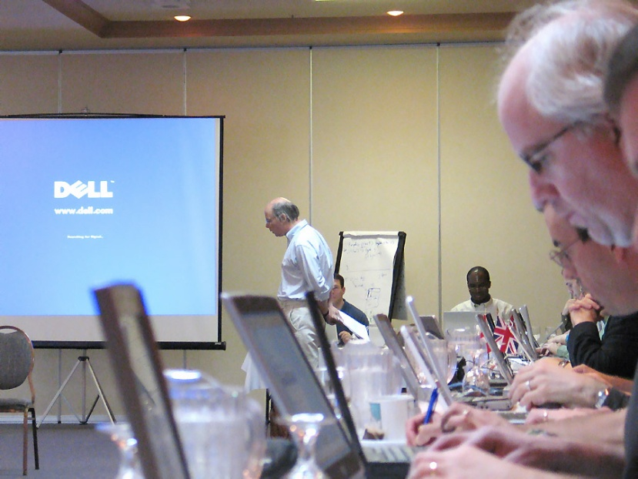
“Minor” new features
Support for generic programming
auto – deduce variable type from initializer
Template aliases (formerly “template typedefs”)
decltype – express type in terms of expressions
Variadic templates
Move semantics (rvalue references)
“range” for statement
lambdas
Other
constexpr – Generalized constant expressions
static_assert – compile-time assertions
class enumerations
nullptr – a name for the null pointer
Delegating and forwarding constructors
Control of defaults
User-defined literals
…

Slide 71
>>
Now legal (about time too!):
vector<list<int>> v;
Smallest extension (removes one space)

Slide 72
auto – get the type from the initializer
My favorite small extension
I implemented it in 1982 (or 1983)
Rejected as C incompatibility ☹
Clashed with “implicit int”
Examples
auto x = n*m;
for(auto p = v.begin(); p!=v.end(); ++p) …
// for(vector<int>::iterator p = v.begin(); p!=v.end(); ++p) …
Not for argument types or return values ☹
auto square(auto x) { return x*x; } // error

Slide 73
Generalized constant expressions
Simple, fairly general type-safe compile-time evaluation
Not macro hacking with just ints
Gabriel Dos Reis and Bjarne Stroustrup: General Constant Expressions for System Programming Languages. SAC-2010. The 25th ACM Symposium On Applied Computing. March 2010.

Slide 74
Generalized constant expressions
Simple inline functions can be used in constant expressions
When given constant expressions as arguments
constexpr int square(int x) { return x * x; } // fine
constexpr int max(int a, int b)
{ if (a>b) return a; else return b; } // error: constexpr too complicated
// so use: (a>b)?a:b
const double mass = 9.8;
double e1 = mass * square(56); // ok: constant expression
extern int val;
double s2 = square(val); // ok: not constant expression

Slide 75
Generalized constant expressions
Guarantee compile-time initialization
const double mass = 9.8;
constexpr double e1 = mass * square(56); // ok: constant expression
int val = 42;
constexpr double s2 = square(val); // error: not constant expression

Slide 76
Generalized constant expressions
constexpr can be used for constructors
This gives us static initialization of objects
Literals of class types
Think ROM
struct complex {
constexpr complex(double r, double i) : re(r), im(i) { }
constexpr double real() { return re; }
constexpr double imag() { return im; }
private:
double re;
double im;
};
constexpr complex I {0, 1}; // ok: literal complex
constexpr double r {I.real()};

Slide 77
Null pointer – an old problem
Examples
void f(int);
void f(char*);
f(0); // calls f(int) – of course, 0 is an int
f(NULL); // calls f(int) – of course(!?) NULL is a macro for 0
f((char*)0); // calls f(char*) - ugly
f((char*)NULL); // loud and ugly
People differ about “what the null pointer really is”
Ideals differ (a bit)
One null pointer for all pointer types
One separate null pointer for each pointer type

Slide 78
nullptr – a solution (partial)
The null pointer is called nullptr (a new keyword)
void f(int);
void f(char*);
f(nullptr); // calls f(char*): nullptr is not an int
f(0); // calls f(int): 0 is an int
0 still converts to the null pointer
void g(char*);
g(0); // OK
NULL is still a macro for 0
People seem to chose (dubious) compatibility for utility ☹
There is just one nullptr
not a nullptr<T> for each T

Slide 79
Range for statement
Simple traversal of all elements in a sequence:
for (int x : v) cout << x << ‘\n’;
We can define a sequence for every container
And ranges, e.g. initializer_list, (even arrays):
template<class C>
void clear_elements(C& c)
{
for (auto& x : c) x = {}; // using & avoids copying and allows writing
}

Slide 80
Enum class
Strongly typed and scoped
enum Alert { green, yellow, election, red }; // traditional enum
enum class Color { red, blue }; // strongly typed enum
enum class TrafficLight { red, yellow, green };
Alert a = 7; // error (as ever in C++)
Color c = 7; // error
int a2 = red; // ok: Alert->int conversion
int a3 = Alert::red; // error in C++98; ok in C++03
int a4 = blue; // error: blue not in scope
int a5 = Color::blue; // error: not Color->int conversion
Color a6 = Color::blue; // ok

Slide 81
Enum class
Defined underlying type
enum class Color : unsigned int { red, blue };
enum class TrafficLight { red, yellow, green }; // underlying type is int
enum E { E1 = 1, E2 = 2, Ebig = 0xFFFFFFF0U };
// quick!
// What are the possible underlying types of E?
// Is Ebig greater than or less than -1?
// What do the compilers do?

Slide 82
Classical enum
Compiler | Ebig = ? | E1 ? -1 | Ebig ? -1 | Warning
Borland 5.5.1 | -16 | greater | less | none
Digital Mars 8.38 | 4294967280 | greater | greater | none
Comeau 4.3.3 (EDG 3.3) | 4294967280 | less | less | integer conversion resulted in a change of sign
gcc 2.95.3 | 4294967280 | less | less | comparison between signed and unsigned
gcc 3.3.2 | 4294967280 | less | less | comparison between signed and unsigned integer expressions
Metrowerks CodeWarrior 8.3 | -16 | greater | less | none
Microsoft Visual C++ 6.0 | -16 | greater | less | none
Microsoft Visual C++ 7.1 | 4294967280 | less | less | none
Microsoft Visual C++ 8.0 (alpha) | -16 | greater | less | signed/unsigned mismatch

Slide 83
Static assertions
Compile time assertions
Not macro hacking
Failure is compilation error
String printed in case of failure
Syntactically a declaration (so it can appear just about everywhere)
static_assert(4<=sizeof(int) , "32-bit its needed");
template <class charT, class traits>
class basic_string {
static_assert(is_pod<charT>::value,
"std::basic_sting character type must be a POD");
// ...
};

Slide 84
Lambdas
Example: Find element less that 7”
C++98: you must use a non-local class
struct Less_than {
int v;
Less_than(int vv):v(vv) { }
bool operator()(int x) const { return x<v;}
};
void f(vector<int>& v)
{
auto p = find_if(v.begin(), v.end(), Less_than(7));
}

Slide 85
Lambdas
Example: “Find element less that 7”
C++0x: you can use a local class
void f(vector<int>& v)
{
struct Less_than {
int v;
Less_than(int vv):v(vv) { }
bool operator()(int x) const { return x<v;}
};
auto p = find_if(v.begin(), v.end(), Less_than(7));
}

Slide 86
Lambdas
Example: “Find element less that 7”
C++0x: you can use lambda
(an expression generating an anonymous function object)
void f(vector<int>& v)
{
auto p = find_if(v.begin(), v.end(), [](int x){return x<7;});
}

Slide 87
Lambdas
“Capture” local variables
By value or by reference
void f(vector<int>& v)
{
int loc;
auto p1 = find_if(v.begin(), v.end(), [&loc](int x){return x<loc;});
auto p2 = find_if(v.begin(), v.end(), [loc](int x){return x<loc;});
auto p3 = find_if(v.begin(), v.end(), [&](int x){return x<loc;});
auto p4 = find_if(v.begin(), v.end(), [=](int x){return x<loc;});
}

Slide 88
Lambdas
Think of an algorithm over a sequence as equivalent to a loop:
Also in run-time performance
long sum = 0;
for (int i =0; i<v.size(); ++i) sum+=v[i];
for (auto p = v.begin(); p<v.end(); ++p) sum+=*p;
for (auto x : v) sun+=x;
for_each(v.begin(), v.end(), [&sum](int x){ sum+=x;});
for_each(v.begin(), v.end(), [&](int x){ sum+=x;});
for_every_second(v.begin(), v.end(), [&](int x){ sum+=x;});
auto i = find_if( v.begin(), v.end(), []( int i ) { return i>x && i<y; } );

Slide 89
Move semantics
template<class C, class V>
vector<typename C::iterator> find_v(C& s, V v) // note: return by value!
// find all occurrences of v in s
{
vector<typename C::iterator> res;
for (auto p = s.begin(); p!=s.end(); ++p)
if (*p==v) res.push_back(p);
return res;
}
vector<string> m = { "Dennis", "Joe", "Brian", "Al", "Joe", "Bill" };
for (auto x : find_v(m,"Bill"))
if (x!= "Bill") cerr << "bug!\n";

Slide 90
Rvalue initializers
Primarily a feature for library implementers
Real reason: performance
Perfect forwarding
Eliminate spurious copies
Can be invisible to users

Slide 91
Rvalue initializers
Used to implement move constructors and move assignments:
template<class T> class vector { // slightly simplified
int sz;
T* elem;
// …
vector(const vector& a) :sz{a.sz}, elem{new T[sz]} // copy constructor
{ // copy elements
uninitialied_copy(a.elem,a.elem+sz, elem);
}
vector(vector&& a) : sz{a.sz}, elem{a.elem} // move constructor
{ // leave behind an empty vector
a.sz = 0;
a.elem = nullptr;
}
};

Slide 92
A C++98 problem: excess copying
template <class T> swap(T& a, T& b) // “old style swap”
{
T tmp{a}; // now we have two copies of a
a = b; // now we have two copies of b
b = tmp; // now we have two copies of tmp (aka a)
}

Slide 93
Rvalue initializers
Avoiding copying
template <class T>
void swap(T& a, T& b) // “perfect swap”
{
T tmp = move(a);
a = move(b);
b = move(tmp);
}
template <class T>
typename remove_reference<T>::type&& move(T&& a)
{
return a;
}

Slide 94
Rvalue initializers
Perfect forwarding
preserve lvalueness and rvalueness
template<class A1> void f(A1&& a1) // perfect forwarding
{
return g(forward<A1>(a1));
}
f(5); // rvalue
int a = 5;
f(a); // lvalue

Slide 95
Rvalue initializers
Perfect forwarding
preserve lvalueness and rvalueness
template <class T> struct identity { typedef T type; };
template <class T>
T&& std::forward(typename identity<T>::type&& a)
{
return a;
}

Slide 96
Variadic templates
Deal with arbitrary numbers of arguments of arbitrary types at compile time
In a type-safe manner
void printf(const char s[]) // handle a printf without non-format arguments
{
while (s && *s) {
if (*s == '%' && ++*s != '%')
throw runtime_error("invalid format: missing arguments");
std::cout << *s++;
}
}

Slide 97
Variadic templates
template<typename T, typename... Args> // note …
void printf(const char s, T value, Args... args) // note …
{
while (s && *s) {
if (*s == '%' && *++s != '%') {
std::cout << value; // use first non-format argument
// note: no use of format specifier
return printf(++s, args...); // “peel off” first argument
}
std::cout << *s++;
}
throw std::runtime error("extra arguments provided to printf");
}

Slide 98
Control of defaults
Disallow copying:
class X {
X& operator=(const X&) = delete;
X(const X&) = delete;
};
Default copying:
class Y {
Y& operator=(const Y&) = default;
Y(const Y&) = default;
};
Eliminate undesired conversions:
struct Z {
Z( long long ); // can initialize with an long long
Z( long ) = delete; // but not anything less
};

Slide 99
User-defined literals
Examples
"Hi!"s // string, not “zero –terminated array of char”
1.2i // imaginary
123.4567891234df // decimal floating point (IBM)
101010111000101b // binary
123.56km // not miles! (units)
123456789012345678901234567890x // extended-precision
How you define them?
What do they mean?
History
Decimal floating point was a major motivation

Slide 100
Cooked or raw?
Consider
1.2i // we’d like 1.2*i (“cooked”)
123456789012345678901234567890x // we need to treat that // number as a string (“raw”)
Mapping functions
complex<double> operator "i"(double d); // pass cooked (as double)
➔ operator "i"(1.2);
Bignum operator "x" (const char*); // pass raw (as characters)
➔ operator "x"("123456789012345678901234567890");

Slide 101
Parsing (lexing)
The rules apply after usual lexical parsing
Max Munch
Hello_world // and identifier, not “hello” with a suffix “_world”
You can’t redefine existing suffices
0x101b // hexadecimal, not binary
String concatenation
"asdf " "lkjh"s // a std::string
Floating-point “assembly”
1.2e-5df

Slide 102
Variants
user-defined-literal:
user-defined-integer-literal
user-defined-floating-literal
user-defined-string-literal
user-defined-character-literal

Slide 103
Compile time vs. run time
Obviously(?) we prefer compile-time “assembly”
constexpr complex<double> operator "i"(long double d)
{
return {0,d}; // complex<double > is a literal type
}
But we can’t do everything at compile-time
std::string operator "s"(const char* p, size_t n) // cooked
{
return string(p,n); // requires free store allocation
}

Slide 104
Template literal operators
Are they nuts?
Sure, but …
How do you use user-defined literals in constants?
e.g. for template metaprogramming
Ordinary templates
enum class TLA { nbg, mph, tla, npl, tlo };
template<char c1, char c2, char c3> TLA operator "_tla"();
"NBG"_tla ➔ operator "_tla" <'N', 'B', 'G'>();
Variadic templates
template<char…> TLA operator "dig"();
123dig ➔ operator "dig" <'1', '2', '3'>();

Slide 105
Scope
Literal operators
Are namespace scope functions (not members)
The usual scope rules apply
Suffices tends to be “short and common”
E.g., x, i, m, …
How to avoid clashes; stick them into a namespace:
// File a.h:
namespace A {
class X { /* … */ };
namespace literals {
operator "X"(char const*);
}
}
using namespace A::literals; // for maximum control, don’t put into header

Slide 106
Scope
// File b.h:
namespace B {
class ExtNum { /* … */ };
namespace literals {
operator "X"(char const*);
}
}
using namespace B::literals;
// File main.c:
#include "a.h"
#include "b.h" // No conflict.
X xx = 123X; // Error: Ambiguous

Slide 107
Order
Try in order for somethingx
operator "x" X (n ULL) // cooked
operator "x" X ("n ") // uncooked
operator "x" X <’c1’, ’c2’, ... ’ck’>()
operator "x" X (f L)
operator "x" X ("f ")
operator "x" X <’c1’, ’c2’, ... ’ck’>()
operator "x" X (str , len ) // cooked
You can’t have a cooked and an uncooked “version” for an x

Slide 108
Not done
Prefixes
S"asdf" // in this way lies (parsing and ambiguit) madness
Separators
1010_1111_0101_0000b // Crowl proposal
1010 1111 0101 0000b // “overloaded whitespace”
Standard library
No s, b, or _i18n ☹

Slide 109
The C++0x standard library
Overview
Tuple
Containers

Slide 110
Overview
smart pointers: shared_ptr, weak_ptr, and unique_ptr
garbage collection ABI
Improvements to algorithms
array
Improvements to containers
forward_list a singly-liked list
tuple and other utilities
thread
Time utilities
abandoning a process
future and promise
atomic operations
random number generators
unordered_map (and unordered multimap, set, multiset)
metaprogramming and type traits
regex a regular expression library
scoped allocators

Slide 111
Overview
Containers
array a fixed-sized array/vector
Improvements to containers
forward_list a singly-liked list
How does a C++0x container differ from a C++98 container
Utilities
tuple
function
Algorithms

Slide 112
23.3.1 Class template array
Fixed length array
like built-in array, but
No nasty pointer decay
Knows its size
Has STL interface (e.g. begin() and end(), assignment, and pass-by-value)
array<int, 6> a1= { 1, 2, 3 };
array<int> a2 = { 1, 2, 3 }; // error: size unknown/missing
Zero-length array
array<int,0> a0; // ok

Slide 113
23.3.1 Class template array
template <class T, size_t N > struct array {
// …
// capacity:
constexpr size_type size() const;
constexpr bool empty() const;
// element access:
reference operator[](size_type n);
const_reference operator[](size_type n) const;
const_reference at(size_type n) const;
// …
T * data(); // get a pointer to elements
const T * data() const;
};

Slide 114
23.3.3 Class template forward_list
A forward_list is a container that supports forward iterators and allows constant time insert and erase operations anywhere within the sequence, with storage management handled automatically. Fast random access to list elements is not supported.
[ Note: It is intended that forward_list have zero space or time overhead relative to a hand-written C-style singly linked list. Features that would conflict with that goal have been omitted.—end note ]
A forward_list satisfies all of the requirements of a container (table 80), except that the size() member function is not provided. Descriptions are provided here only for operations on forward_list that are not described in that table or for operations where there is additional semantic information.
template <ValueType T, Allocator Alloc = allocator<T> >
requires NothrowDestructible<T>
class forward_list {
// no size
};

Slide 115
Lists
Should a list have size() be O(1)?
Everybody’s first answer is Yes!
If so every list gets one more word
The empty list doubles in size
There are lots of empty lists!
Alternative (for all containers):
Trade time for space
And hope caching will take care of the time
container
Descriptor
Elem size
element

Slide 116
std::vector – what’s new?
What’s new in the language?
Initializer_list
Rvalue references
Variadic templates
Plus real allocator objects

Slide 117
std::vector – what’s new?
Moving element is a major cost in many algorithms
vector<string> v;
String s = "Doctor Who";
v.push_back(s); // must copy (expensive)
v.push_back("Doctor Who"); // can move rvalue (much cheaper)
v.emplace_back("Doctor Who"); // build string in place (cheapest)
You’ll need to look at real performance data to know if there is a significant different between the last two cases
Note that you don’t actually need more than one argument for emplace()
Wikipedia:
Emplace
Verb
to emplace (third-person singular simple present emplaces, present participle emplacing, simple past and past participle emplaced)
To assign a position to something, or to locate something at a particular place

Slide 118
std::vector – what’s new?
template <ValueType T, Allocator Alloc = allocator<T> >
requires MoveConstructible<T>
class vector {
public:
// …
requires AllocatableElement<Alloc, T, const T&> && CopyAssignable<T>
vector<T,Alloc>& operator=(const vector<T,Alloc>& x);
requires AllocatableElement<Alloc, T, T&&> && MoveAssignable<T>
vector<T,Alloc>& operator=(vector<T,Alloc>&& x);
requires AllocatableElement<Alloc, T, const T&> && CopyAssignable<T>
vector<T,Alloc>& operator=(initializer_list<T>);
// …
};

Slide 119
Tuples
In the old days
Just use N arguments where N is more than you need
struct unused {};
template<class T1 = unused, class T2 = unused, class T3 = unused>
class Tuple { // can be used with 0 to N arguments
// How big does N has to be in real life?
T1 v1; T2 v2; T3 v3; // a waste of space
public:
Tuple();
Tuple(T1);
Tuple(T1,T2);
Tuple(T1, T2, T3); // a lot of typing
// …
};

Slide 120
Tuple
Avoid the unused arguments and waster space
// specialize (and don’t bother implementing the general case):
template<> class Tuple<> {
public:
Tuple();
// …
};
template<class T1>
class Tuple<T1> {
T1 v1;
public:
Tuple(T1);
// …
};
// …

Slide 121
Tuple
What do you want tuples for?
Heterogeneous structures
that you don’t want to write “by hand”
pair<T1,T2> is the simplest tuple
(and arguably most useful)
E.g. name/value pair
E.g. return-code/value pair
List of bound arguments in a bound function (Currying)
E.g. the implementation of std::bind()

Slide 122
Tuples
Note
We never store the types (only values of types)
There is no standard run-time representation of types in C++
Like all template-based schemes tuples are compiler-based
The tuple values are stored contiguously
Not as a linked structures
The zero-overhead principle holds

Slide 123
Tuples
How to make a general (variadic) tuple
Rumor has it that you can do it differently “but not easily or elegantly”
template<typename... Elements> class tuple; // general tuple (never used)
template<typename Head, typename... Tail> // N-tuple for 1<=N
class tuple<Head, Tail...>
: private tuple<Tail...> // note: base class depending on template argument
// note: private base class
{
Head head; // each added type adds one member to the final class
public:
// …
};
template<>
class tuple<> { // zero-tuple
// …
};

Slide 124
Tuples
How to make a general (variadic) tuple
template<typename Head, typename... Tail> // N-tuple for 1<=N
class tuple<Head, Tail...>
: private tuple<Tail...> // note: base class depending on template argument
// note: private base class
{
Head head; // each added type adds one member to the final class
public:
tuple();
tuple(const tuple&);
template <class... UTypes>
tuple(const tuple<UTypes...>&);
tuple& operator=(const tuple&);
template <class... UTypes>
tuple& operator=(const tuple<UTypes...>&);
void swap(tuple& rhs);
};

Slide 125
Tuples
How to make a general (variadic) tuple
template<VariableType... Types> // remove implementation details
// for standards description
class tuple {
public:
// add concepts
// add rvalue constructors and assignments
// add allocators to constructors and assignments
};

Slide 126
20.5.2 Class template tuple
template <VariableType... Types>
class tuple {
public:
requires DefaultConstructible<Types>...
tuple();
template <class... UTypes> requires Constructible<Types, UTypes&&>...
explicit tuple(UTypes&&...);
requires CopyConstructible<Types>...
tuple(const tuple&);
template <class... UTypes> requires Constructible<Types, const UTypes&>...
tuple(const tuple<UTypes...>&);
template <class... UTypes> requires Constructible<Types, RvalueOf<UTypes>::type>...
tuple(tuple<UTypes...>&&);
template <class... UTypes> requires Constructible<Types, const UTypes&>...
template <class... UTypes> requires Constructible<Types, RvalueOf<UTypes>::type>...
// allocator-extended constructors
template <Allocator Alloc> requires ConstructibleWithAllocator<Types, Alloc>...
tuple(allocator_arg_t, const Alloc& a);
template <Allocator Alloc, class... UTypes> requires ConstructibleWithAllocator<Types, Alloc, UTypes&&>...
explicit tuple(allocator_arg_t, const Alloc& a, UTypes&&...);
template <Allocator Alloc, class... UTypes> requires ConstructibleWithAllocator<Types, Alloc, const UTypes&>...
tuple(allocator_arg_t, const Alloc& a, const tuple<UTypes...>&);
template <Allocator Alloc, class... UTypes> requires ConstructibleWithAllocator<Types, Alloc, RvalueOf<UTypes>::type>...
tuple(allocator_arg_t, const Alloc& a, tuple<UTypes...>&&);
template <Allocator Alloc, class... UTypes> requires ConstructibleWithAllocator<Types, Alloc, const UTypes&>...
tuple(allocator_arg_t, const Alloc& a, const pair<UTypes...>&);
template <Allocator Alloc, class... UTypes> requires ConstructibleWithAllocator<Types, Alloc, RvalueOf<UTypes>::type>...
tuple(allocator_arg_t, const Alloc& a, pair<UTypes...>&&);
requires CopyAssignable<Types>...
tuple& operator=(const tuple&);
template <class... UTypes> requires HasAssign<Types, const UTypes&>...
tuple& operator=(const tuple<UTypes...>&);
template <class... UTypes> requires HasAssign<Types, RvalueOf<UTypes>::type>...
tuple& operator=(tuple<UTypes...>&&);
template <class... UTypes> requires HasAssign<Types, const UTypes&>...
template <class... UTypes> requires HasAssign<Types, RvalueOf<UTypes>::type>...
requires Swappable<Types>... void swap(tuple&& rhs);
};

Slide 127
20.5.2 Class template tuple
template <VariableType... Types>
class tuple {
public:
requires DefaultConstructible<Types>...
tuple(); // default constructor
requires CopyConstructible<Types>...
tuple(const tuple&); // copy constructor: same type: T u2 = u;
template <class... UTypes> requires Constructible<Types, UTypes&&>...
explicit tuple(UTypes&&...); // move from arguments: T u(a,b,c)
template <class... UTypes> requires Constructible<Types, const UTypes&>...
tuple(const tuple<UTypes...>&); // copy from compatible type: T u = v;
template <class... UTypes> requires Constructible<Types, RvalueOf<UTypes>::type>...
tuple(tuple<UTypes...>&&); // move from compatible type: T u = v;
template <class... UTypes> requires Constructible<Types, const UTypes&>...
tuple(const pair<UTypes...>& u); // copy first u.first and u.second
template <class... UTypes> requires Constructible<Types, RvalueOf<UTypes>::type>...
tuple(pair<UTypes...>&& u); // move from first u.first and u.second
};

Slide 128
20.5.2 Class template tuple
template <VariableType... Types>
class tuple
{
// …
// allocator-extended constructors
// each of these constructors passes its constructor on to its members
template <Allocator Alloc> requires ConstructibleWithAllocator<Types, Alloc>...
tuple(allocator_arg_t, const Alloc& a);
template <Allocator Alloc, class... UTypes> requires ConstructibleWithAllocator<Types, Alloc, UTypes&&>...
explicit tuple(allocator_arg_t, const Alloc& a, UTypes&&...);
template <Allocator Alloc, class... UTypes> requires ConstructibleWithAllocator<Types, Alloc, const UTypes&>...
tuple(allocator_arg_t, const Alloc& a, const tuple<UTypes...>&);
template <Allocator Alloc, class... UTypes> requires ConstructibleWithAllocator<Types, Alloc, RvalueOf<UTypes>::type>...
tuple(allocator_arg_t, const Alloc& a, tuple<UTypes...>&&);
template <Allocator Alloc, class... UTypes> requires ConstructibleWithAllocator<Types, Alloc, const UTypes&>...
tuple(allocator_arg_t, const Alloc& a, const pair<UTypes...>&);
template <Allocator Alloc, class... UTypes> requires ConstructibleWithAllocator<Types, Alloc, RvalueOf<UTypes>::type>...
tuple(allocator_arg_t, const Alloc& a, pair<UTypes...>&&);
// …
};

Slide 129
20.5.2 Class template tuple
template <VariableType... Types>
class tuple
{
// …
requires CopyAssignable<Types>... // assignments
tuple& operator=(const tuple&);
template <class... UTypes> requires HasAssign<Types, const UTypes&>...
tuple& operator=(const tuple<UTypes...>&);
template <class... UTypes> requires HasAssign<Types, RvalueOf<UTypes>::type>...
tuple& operator=(tuple<UTypes...>&&);
template <class... UTypes> requires HasAssign<Types, const UTypes&>...
tuple& operator=(const pair<UTypes...>&);
template <class... UTypes> requires HasAssign<Types, RvalueOf<UTypes>::type>...
tuple& operator=(pair<UTypes...>&&);
requires Swappable<Types>... void swap(tuple&& rhs); // and of course we can swap tuples
};

Slide 130
Tuple helper functions
Make a tuple (deduce the argument types):
template<MoveConstructible... Types> tuple<VTypes...> make_tuple(Types&&... t);
Access Ith element
template <size_t I, VariableType... Types>
requires True<(I < sizeof...(Types))>
typename tuple_element<I, tuple<Types...> >::type& get(tuple<Types...>& t);
Tuples that are pairs of iterators are (in places) common
template<InputIterator Iter>
concept_map Range<tuple<Iter, Iter> > { // [Iter[0];Iter[1])
typedef Iter iterator;
Iter begin(tuple<Iter, Iter>& p) { return std::get<0>(p); }
Iter end(tuple<Iter, Iter>& p) { return std::get<1>(p); }
}
==, !=, <, <=, >, >=

Slide 131
Tuple and pair
A 2-tuple is not a pair, but
You can construct a tuple from a pair
You can assign a pair to a tuple
You can access a pair like a tuple (get<1>() and get<2>())
You cannot construct a pair from a tuple
You cannot assign a tuple to a pair

Slide 132
Summary
C++0x is too BIG and complex
E.g., Concepts, allocators, localization (fortunately localized), “old stuff and C compatibility”
The first C++ manual was 66 pages, the C++0x standard is 1347 pages and growing
Unfair comparison, but …
I’m more worried about “complex” than by “BIG”
If feels like a new language
Much better, smoother, expressive abstraction facilities
Better integration of features
Fewer frustrations, terser and clearer code
You can write better code in C++0x than in C++98
There are far too few standard libraries
Unicode, XML, distributed computing, linear algebra

